Slide 1
Get Kinect-ed
How to make the Microsoft Kinect work for you

Slide 2



Who Am I?
Chris Gardner
Developer – CareEvolution
Chairman – DevSpace Technical Conference
MCT Regional Lead – Eastern US

Slide 3
Road Map
Specifications
System Requirements
Cool Things
Demos

Slide 4
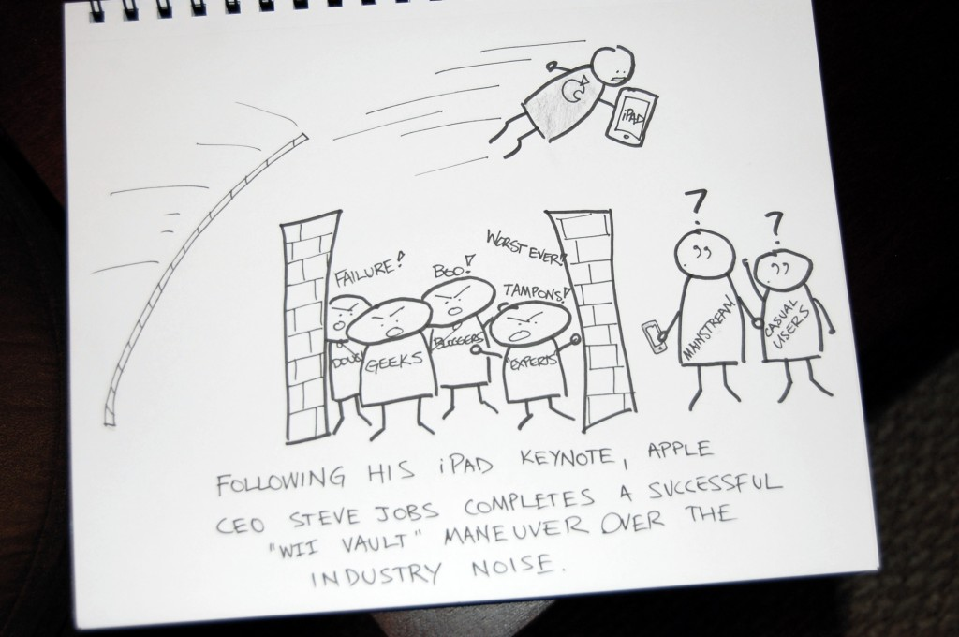
Hardware Specifications

Slide 5
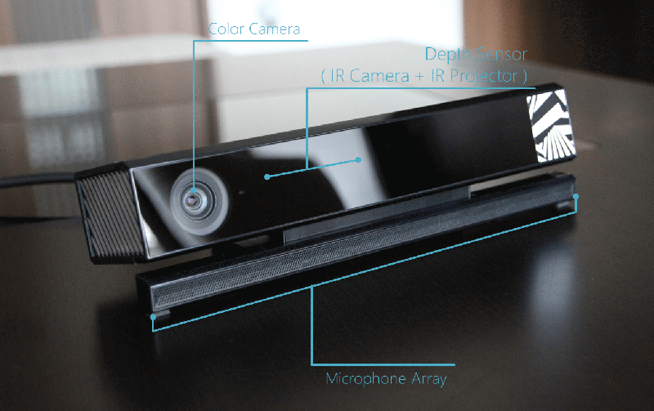
Hardware (External)
Page Source: http://www.eteknix.com/new-windows-v2-kinect-available-for-pre-order-shipping-to-start-on-the-15th-of-july/
Image Source: http://cdn.eteknix.com/wp-content/uploads/2014/06/2014-06-06-image-4.gif

Slide 6
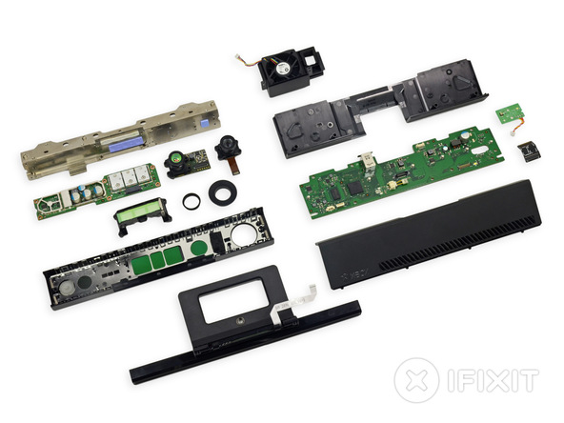
Hardware (Internal)
http://www.tested.com/tech/gaming/459605-whats-inside-xbox-ones-kinect-sensor/
Page Source: http://www.ifixit.com/Teardown/Xbox+One+Kinect+Teardown/19725
Image Source: http://d3nevzfk7ii3be.cloudfront.net/igi/uiyC2e3PiACHCYuu.medium

Slide 7
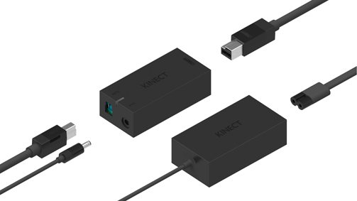
Hardware (Connectors)
Page Source: http://tweakers.net/nieuws/95084/microsoft-toont-hardware-voor-kinect-for-windows-v2.html
Image Source: http://ic.tweakimg.net/ext/i/imagemedium/1395988515.jpeg

Slide 8
Hardware (The Wordy Part)
1080p Color Camera
30fps / 15fps in low light
Depth / Infrared Camera
512x424 at 30fps
Resolution at 0.5 to 4.5 meters
Infrared Emitter
Microphone Array

Slide 9
Recommended System Requirements
Windows 8 or Better
64 bit (x64) processor
4 GB RAM (or more)
Physical dual-core 3.1 GHz (2 logical cores per physical) or faster
USB 3.0 bus dedicated to the v2 sensor
Graphics card that supports DirectX 11

Slide 10
Software Requirements
Visual Studio 2012 or better
.NET Framework 4.5 or better
Kinect for Windows v2 SDK
MS Speech Platform SDK v11
For Speech Recognition
DirectX SDK
For D3D / Native

Slide 11
Kinect SDK
Download at aka.ms/k4w
Required – Installs tools to update the Kinect Firmware
NuGet packages available
Optional – You can directly link to libraries in the installed SDK

Slide 12
SDK Support
Native
.NET
WinRT / UWP
Unity

Slide 13
SDK Tools
Configuration Checker
KinecrMonitor Service - Windows service to handle hardware
Kinect Studio - Record and playback streams of data
Hand Pointer Gestures - WPF/WinRT/UWP built-in gesture support
Gesture Builder
Kinect Fusion / 3D Builder
Face Tracking

Slide 14
What Can We Do With It?
The Kinect blog does a really good job of showcasing cool projects
blogs.msdn.microsoft.com/kinectforwindows
I’ve picked a few good ones to highlight

Slide 15

Aid Shoppers
Prototype supermarket gives information on products to shoppers
“[W]hen a Kinect sensor detected a shopper pointing at an item, an overhead, mirrored display presented an array of detailed product information, extracted from a Microsoft Azure cloud database.”
Page Source: https://blogs.msdn.microsoft.com/kinectforwindows/2015/07/08/kinect-powers-informed-shoppers/
Image Source: https://msdnshared.blob.core.windows.net/media/MSDNBlogsFS/prod.evol.blogs.msdn.com/CommunityServer.Blogs.Components.WeblogFiles/00/00/01/49/02/2210.Avenade-1-419px.png

Slide 16
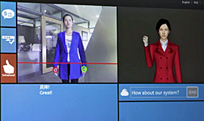
Read Sign Language
Translate to and from sign language
“It is progressing from recognizing isolated words signed by a specific person (translator mode) to understanding continuous communication from any competent signer (communication mode).”
Page Source: https://blogs.msdn.microsoft.com/msr_er/2013/10/29/kinect-sign-language-translator-part-1/
Image Source: https://msdnshared.blob.core.windows.net/media/MSDNBlogsFS/prod.evol.blogs.msdn.com/CommunityServer.Blogs.Components.WeblogFiles/00/00/01/32/81/0724.Kinect-sign-lang-avatar.png

Slide 17
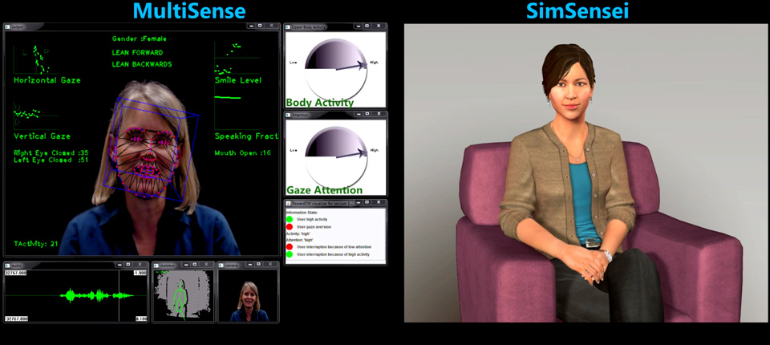
Detect PTSD
Detect early signs of PTSD in soldiers and crisis survivors.
“[W]hen the on-screen virtual human … asks the soldier how he is feeling, the Kinect sensor tracks his overall movement and changes in posture during his reply. These nonverbal signs can reveal stress and anxiety, even if the soldier’s verbal response is `I feel fine.’”
Page Source: https://blogs.msdn.microsoft.com/kinectforwindows/2015/07/01/kinect-helps-detect-ptsd-in-combat-soldiers/
Page Source: http://ict.usc.edu/news/press-releases/ict-virtual-human-health-prototype-named-top-ten-digital-innovation-by-netexplo-forum/
Image Source: http://ict.usc.edu/wp-content/uploads/2013/05/simsensei-1.jpg

Slide 18
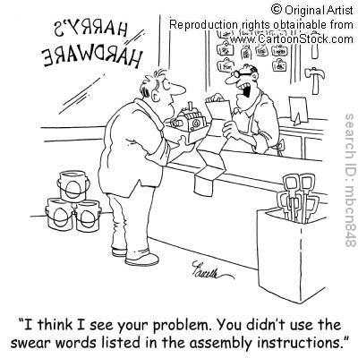
Demo Time

Slide 19
Thank You!
Contact Info
Personal
@freestylecoder
cgardner@gmail.com
Professional
letsfixhealthcare.com
cgardner@careevolution.com
DevSpace
@devspaceconf
devspaceconf.com
cgardner@devspaceconf.com

